Slide 1
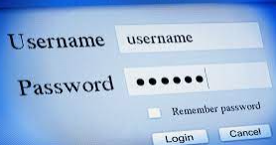
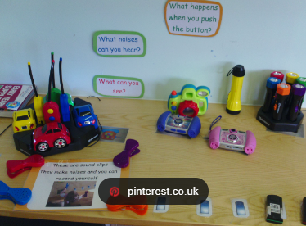
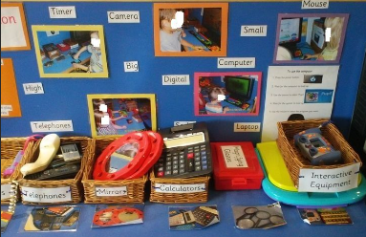
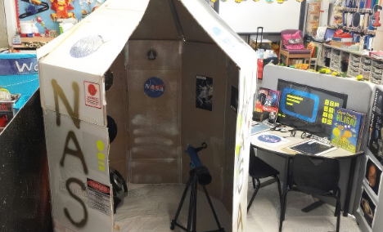
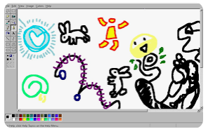
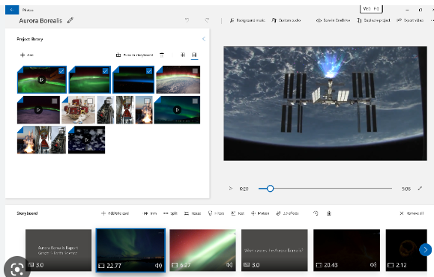
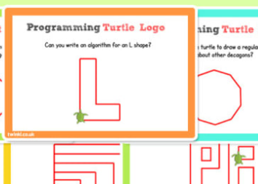
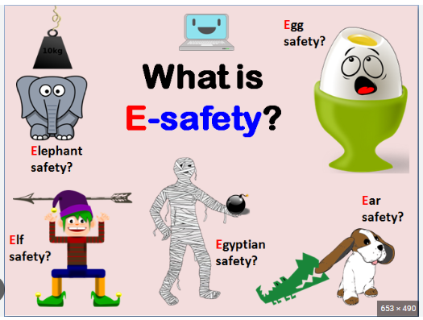
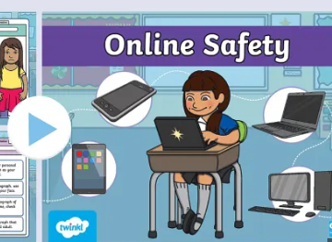
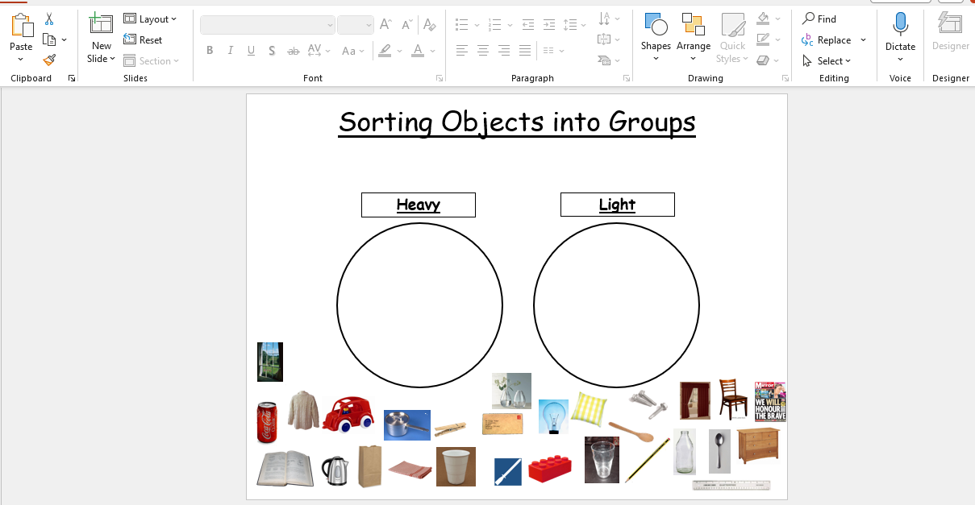
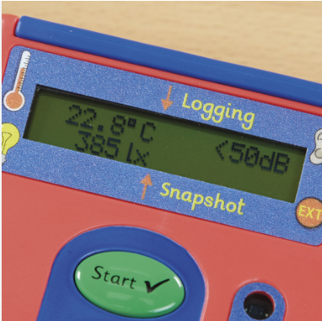
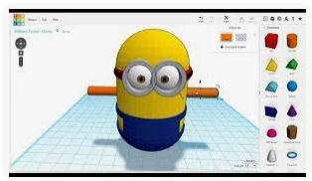
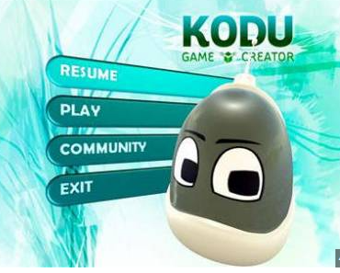
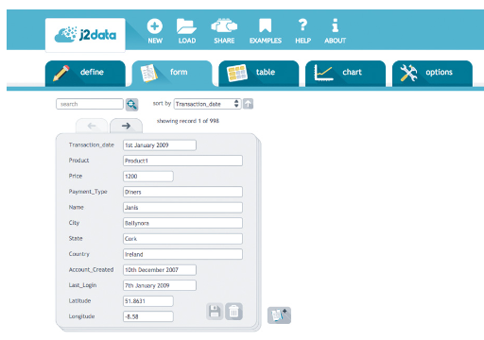
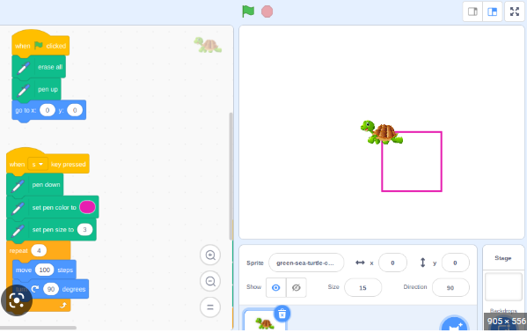
Computing Learning Journey Cycle A
Logging on and mouse control
3
Display
Role Play Area
4
EYFS
KS1
Making paintings and adding text
Animation with Windows Video Editor
Internet Research and Communication
.
Turtle Logo
Online safety
Turtle Logo
5
LKS2
Data Logging
Grouping Data
3D Modelling
Online safety
Year6
UKS2
Extra curricular activities : STEM club
Getting creative with Scratch
Flat File Databases
Computer Networks
Online safety
Programming with Kodu
Extra curricular activities : STEM club

Slide 2
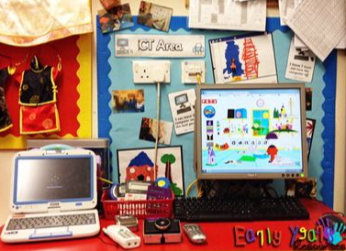
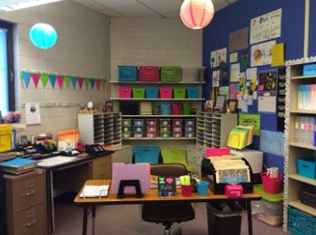
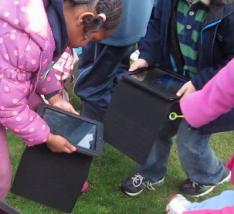
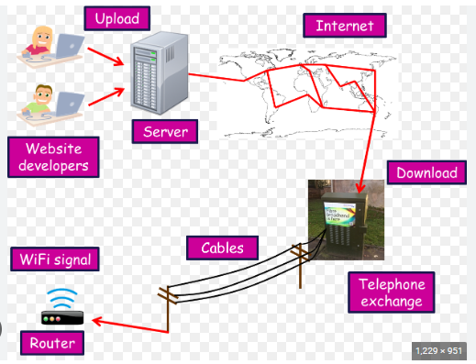
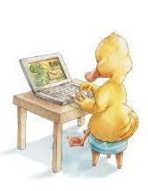
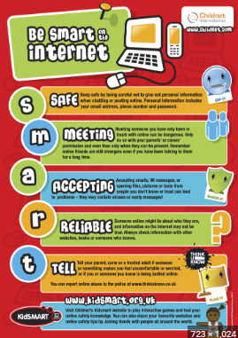
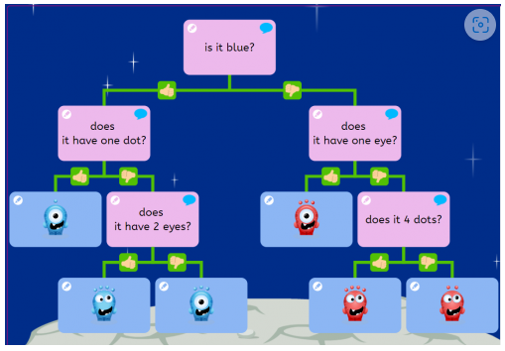
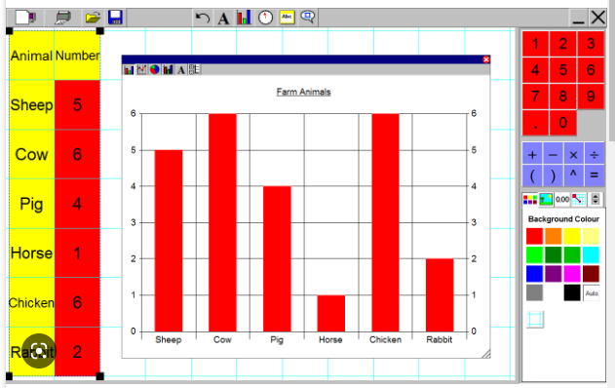
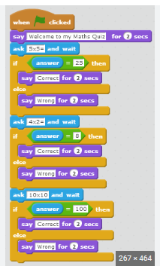
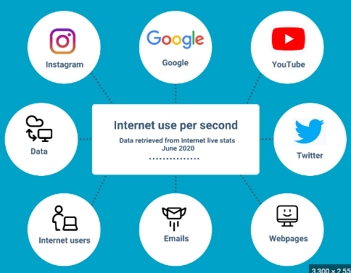
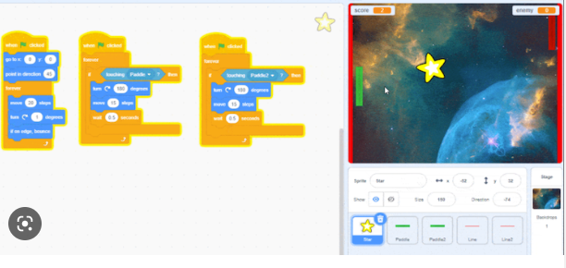
Computing Learning Journey Cycle B
IT All Around Us
3
Computing Area
Role Play
Outdoor Learning
4
EYFS
KS1
Computer Art
Desktop Publishing – text and images
Understanding how the internet words
.
Turtle Logo
Online safety
Inclusivity and Diversity
Reduce cognitive load.
Teach the terminology of computing explicitly and address misconceptions.
Scaffold the learning.
Use unplugged activities and sensory approaches.
Ensure teaching and learning materials accessible and include image or audio support.
Use assistive technology.
Consider classroom layout and seating arrangements for each lesson.
5
LKS2
Digital Data Handling
Branching Databases
Web Page Creation
Online safety
Year6
UKS2
Communication and collaboration
Online safety
Games and Animated Stories with Scratch
Spreadsheets
Scratch – questions and quizzes

